Slide 1
OMV eMotion @ PETROL Summit
October 31st, 2024

Slide 2
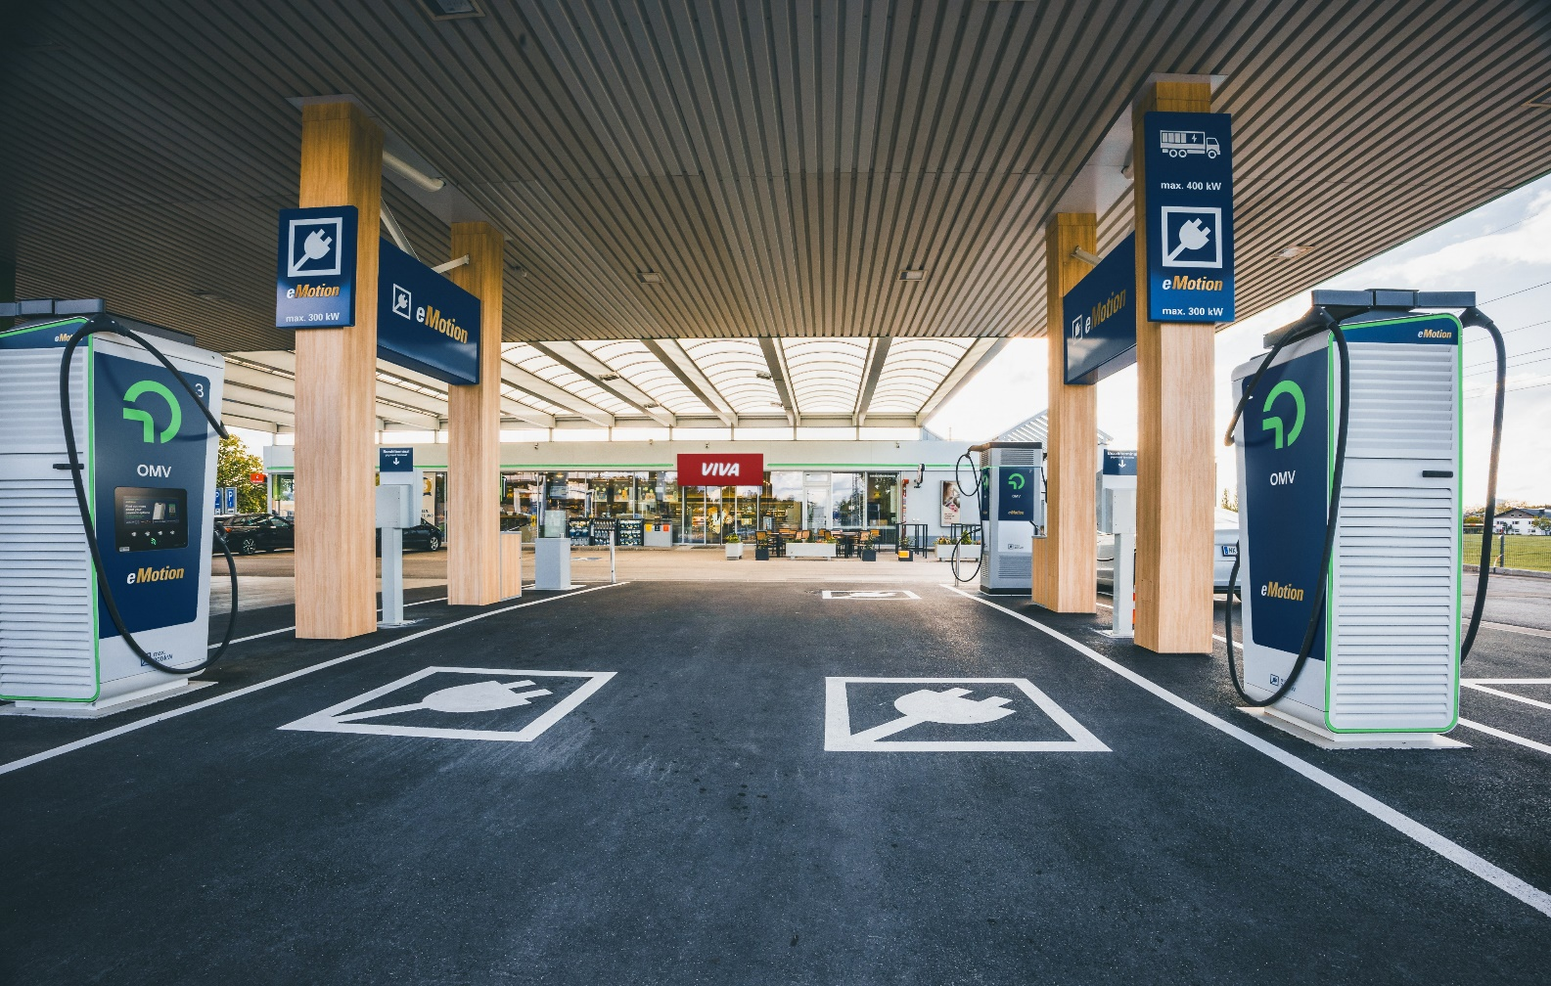
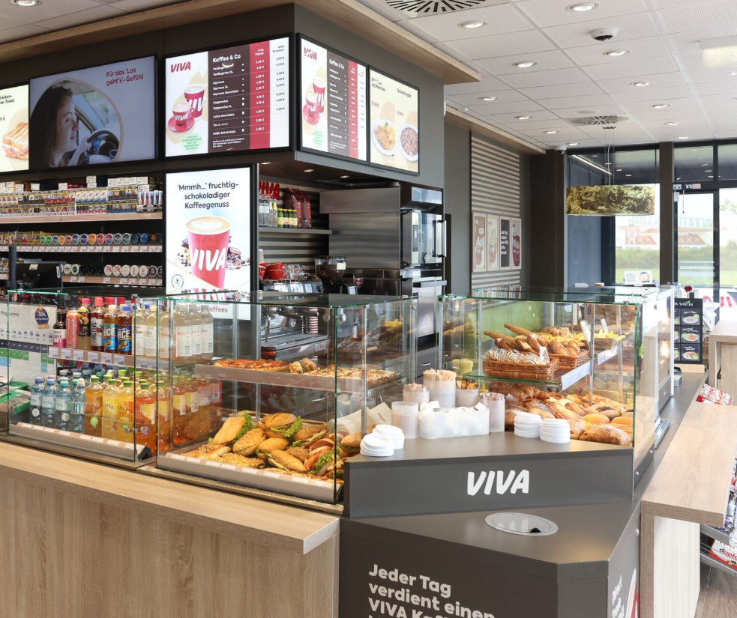
eMotion + Convenience = Winning Offer
RELIABLE
SUSTAINABLE
REWARDING
FAST
SAFE
CLEAN
FRIENDLY FRESH
OMV to become supplier of choice in electromobility segment in AT/HU/RO/SK/BG & CZ – offering full range of services from CPO (charge point operator), MSP (mobility service provider), EV for Heavy Duty Transport (Trucks and Buses), Depot Charging etc., combined with extensive network of filling stations as well as state of the art convenience retail

Slide 3
OMV aiming to claim similar position in EV *HPC as in traditional Retail by the end of 2025
Main HPC operators in OMV core countries as of Q3/24
Main HPC operators in OMV core countries by end of 2025
# HPC charge points
# HPC charge points
# HPC charge points
# HPC charge points
OMV
490
OMV
136
OMV
OMV
# HPC charge points
# HPC charge points
# HPC charge points
# HPC charge points
OMV Petrom
128
OMV Petrom
536
OMV
244
Renovatio**
OMV
Renovatio**
*HPC – High Power Charging **Renovatio 100% owned by OMV Petrom

Slide 4
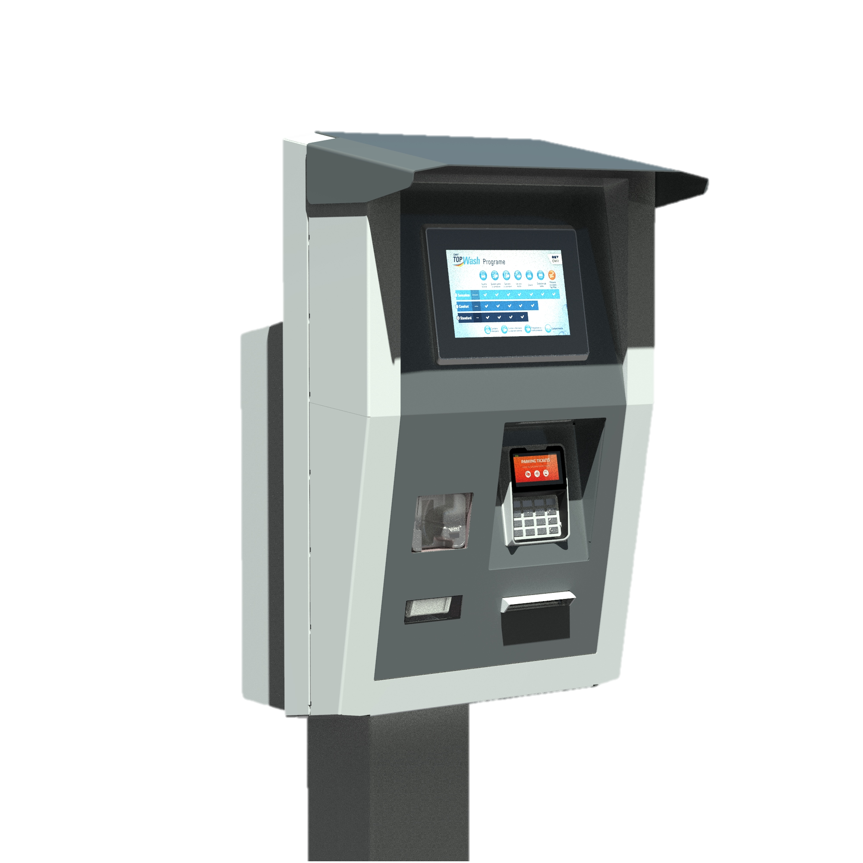
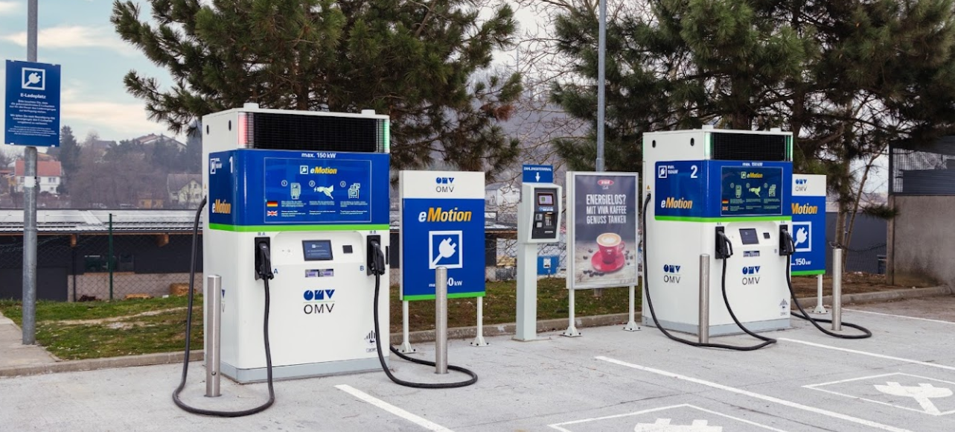
EV Implementation requires big digitalization efforts or smart innovative ideas ☺
OPT as seamless payment solution tool
Independent from HW type/manufacturer
Single device serving multiple chargers
Fleet card acceptance
Loyalty and voucher integration
Upselling possibility and Marketing promotions
Fiscal printer certified for all countries
CPO*
CPO: operating charging infrastructure via backend in our main countries
AT HU
RO SK
How to operate chargers in no time and make customers happy
OMV´s winning offering
MSP** + App
MSP: integration of all internal systems and launch of eMotion App with domestic transactions
AT HU
RO SK
Global
Fraud monitoring tool enhancements & automatization of dunning process
* CPO – Charge point operator ** MSP – Mobility service provider

Slide 5
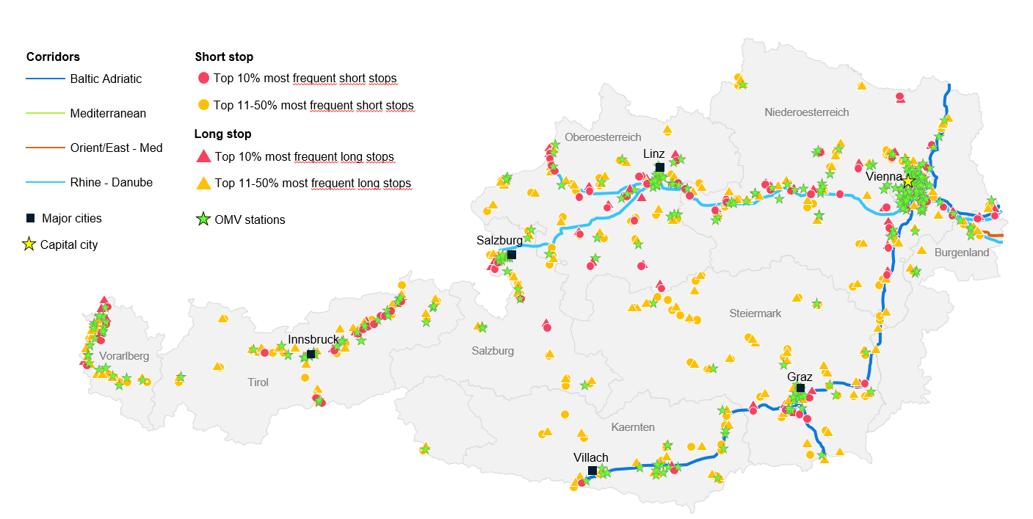
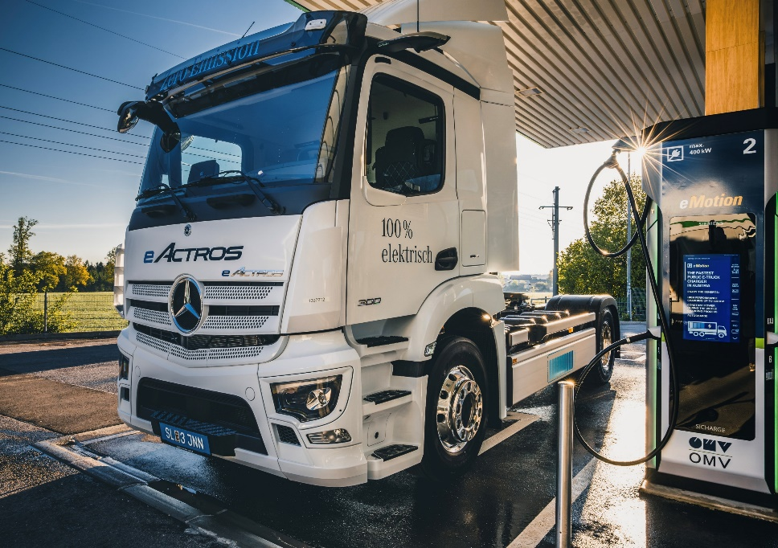
OMV enlarges its EV B2B offering – we are ready when and where our customers need us
Deutsch-Wagram
Laakirchen
Three 400kW chargers in operations at OMV FS for dual usage (Car + Truck)
First CRT charger in AT installed in Völkermarkt
Target of 6 locations in AT by end of 2025 along main transit routes
Inntal (A12)
Bregenz (A14)
Graz (A2)
Already existing OMV EV truck location with 400 kW charger similar to above picture
Völkermarkt
Locations to be developed by end of 2025
OMVs aim to build a 360° offer is based on the development of flexible charging solutions around “Charge at Work” and “Closed Depots” empowering us to cover a variety of scalable and profitable use-cases

Slide 6
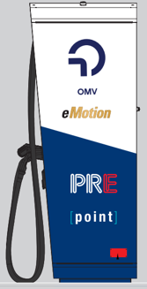
2025 eMotion enters CZ
Czech republic
OMV CZ signed HoT with PRE (leading emobility provider in CZ) to form Joint Venture in Czech republic aiming to develop and operate EV infrastructure at OMV CZ filling stations and beyond

Slide 7
Thank you!

